Slide 1
Calypso - Project Accessible Culture for All
Project partners: Malta as a project leader, Finland and Croatia as observer partner
3 project workshops
Participation at project workshop in Finland
3rd workshop was held in Zagreb
Stakeholders: Association of Croatian Travel Agencies, Union of Croatian Independent Travel Agents, Association of Employers in the Hotel Industry, Croatian Youth Hostel Association, Croatian Association of Paraplegics and Tetraplegics etc.

Slide 2
Calypso - Project Accessible Culture for All
Project aims:
to develop culture that will facilitate social tourism and accessibility for disabled people
to facilitate exchange mechanisms during off-peak season
to build wider knowledge about social tourism
to improve the accessibility dimension of the tourism product and service offer
to set up website

Slide 3
Legal framework and programmes supporting accessibility in tourism sector
Special standards for hotels and label for hotels adjusted for disabled
Special standards for camps, households, rural households and the other types of catering and accommodation facilities
Programme Tourism without barriers (2008-2011)
Programme Step further in 2012
Programme Innovative tourism in 2012 (Film “Tourism without Barriers)

Slide 4
Best practices in the field of accessibility
Publications and guides for people with disabilities (Zagreb, Rijeka, Slavonski Brod, Karlovac)
Accessible museums, transport, accomodation, beaches,tourist sites etc.
Project and initiatives (Travabled, UNDP, Croatian Paralympic Committee)
Useful web sites and interactive maps

Slide 5
Social Tourism in Strategy for Tourism Development by 2020
Social tourism as a measure improving the
competitiveness of the tourism sector
Activities:
Launching of social tourism web site
Development of database on social tourism
Guidelines for adjustment of facilities for all social tourism target groups
Campaign of the importance of social tourism and awareness raising of tourism providers
Development of discounts network for youth
Support to non-profit organizations and youth tourism product creators

Slide 6
EDEN
Participation in all six EDEN editions (2007 – 2012)
2007 – Best emerging rural destionation – Sveti Martin na Muri
2008 – Tourism and local intagible heritage – City of Đurđevac
2009 – Tourism and protected areas – The Northern Velebit National Park
2010 – Aquatic Tourism -
City of Nin
2011 - Tourism and Regeneration of physical sites – Pustara Višnjica

Slide 7
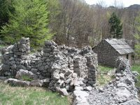
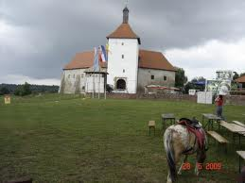
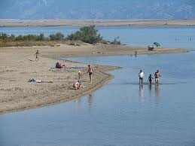
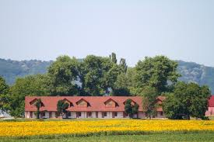
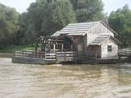
Initiatives to raise visibility of EDEN destinations
Croatian Tourism Days
special prize for the EDEN winner during the Award Ceremony of the action called “I love Croatia” carried out by the Croatian National Tourist Board
live broadcast of the ceremony on national TV

Slide 8
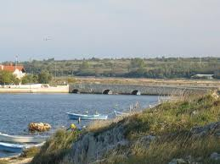
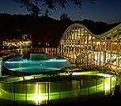
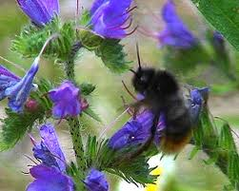
Initiatives to raise visibility of EDEN destinations
Promotion of EDEN destinations via their local/regional web sites, Facebook etc.
Links and information on the web sites of Ministry of Tourism and CNTB
Regular meetings of all EDEN winners with the representatives of the Ministry of Tourism and CTNB

Slide 9
EDEN 2012 – “Promotion of the EDEN project and Croatian destination of excellence
Project leader: CTNB
Activities:
Design and print of posters and leaflets
Production of promotional film
Participation in special presentation (Slovenia, Austria)
Business workshop Buy Croatia
Study tour for foreign journalists
Advertising in national and foreign press
Tourism fairs etc.

Slide 10
CRO – HUN Cooperation
Đurđevac (CRO EDEN 2008) – Írottkő Nature Park (HUN EDEN 2009)
Interest in cooperation:
Pustara Višnjica (EDEN 2011)
Sveti Martin na Muri (EDEN 2007)
Project "Twinning cities”
Sveti Martin na Muri – Szigetszentmiklós (HUN)

